Slide 1
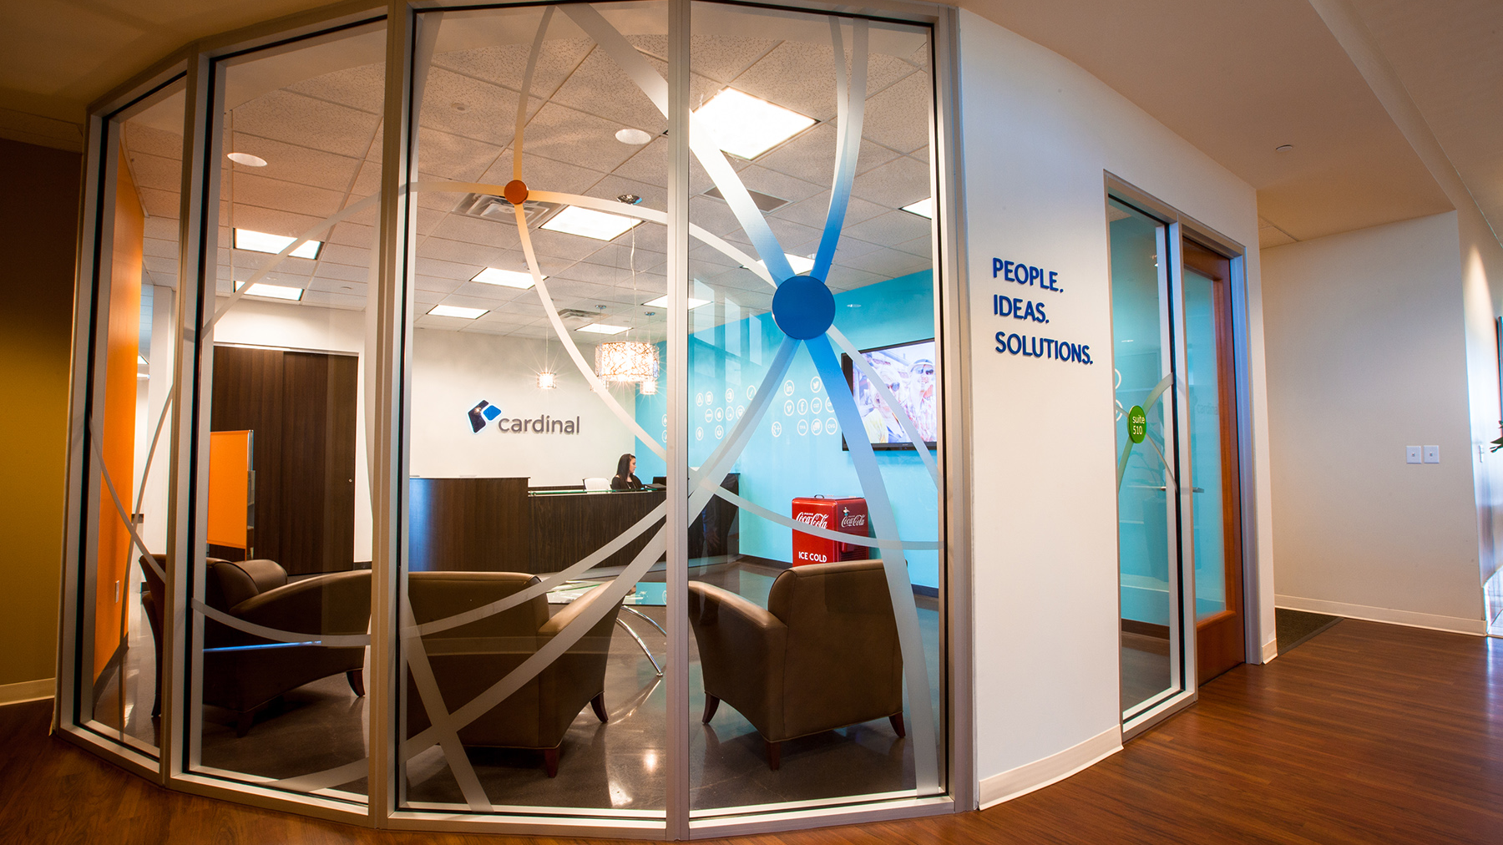

DevOps - The Promise of Agility, Delivered
Nicolas Martin
Adam Essenmacher
Nate Lusher
May 25, 2016
Notes:
Nick

Slide 2
Agenda
What we will cover
1
What is DevOps?
What is the Goal?
How does DevOps help?
How do we get there?
2
3
4
Notes:
Adam

Slide 3
What is devops?
DevOps - The Promise of Agility, Delivered
Notes:
Adam

Slide 4
Like Agile, DevOps IS…
What is DevOps?
An Approach – not a Methodology or Toolset
A Way to Improve Software Delivery
A Cultural and Philosophical Shift
Notes:
Adam
What is DevOps? An approach to improve software delivery by aligning organizational and cultural goals.

Slide 5
DevOps Is Evolutionary. Once We Had Three Silos - Each With Its Own Goal
What is DevOps?
Business
Development
QA
Operations
Deliver Features
No Production Defects
No Production Incidents/Downtime
Notes:
Nick
Traditionally, people were organized around very different goals.
Developers wanted to build things.
QA wanted to make sure things work as intended and expected.
Operations to make sure everything hums along: want stability.

Slide 6
DevOps Is Evolutionary. Agile Typically Aligned Dev & QA
What is DevOps?
Business
Operations
Development
QA
Deliver Features &
No Production Defects
Scrum Team
No Production Incidents/Downtime
Notes:
Nick
With scrum team you get alignment around delivering features and reducing defects.
** This wasn’t mandated by agile processes like Scrum, but is how they were typically implemented.
Operations usually still left to operate in its silo.
Still leaves some friction between competing interests.
** We’ll discuss this more later

Slide 7
DevOps Is Evolutionary. DevOps Aligns All Three
What is DevOps?
Business
Development
Operations
QA
Deliver Features &
No Production Defects &
No Production Incidents/Downtime
Delighting Customers!
DevOps
Notes:
Nick
DevOps finally eliminates that last silo.
The combination of all 3 concerns aligned the team as a whole around all 3 goals collectively.
Delivering features, with few defects and downtime leads to delighted customers.
Delighting customers becomes the unified goal.
** As stated in the quote from the guys at chef

Slide 8
What is the Goal?
DevOps - The Promise of Agility, Delivered
Notes:
Adam

Slide 9



The Goal of Software Professionals
What is the Goal?
Deliver value-driven software as quickly as possible with the highest possible degree of reliability
Notes:
Adam
What is the goal of you and I, as software professionals?

Slide 10
Continuous Delivery
What is the Goal?
Always deployable
Feedback on production readiness with every change
Push-button deployments
Any version
Any environment
Any time
“Done” means stable release candidate
Continuous Delivery ≠ Continuous Deployment
Notes:
Adam
This goal is enabled by Continuous Delivery, which is a state where…

Slide 11

DevOps (secret sauce)
Agile “Ceremonies”
Continuous Delivery
Notes:
Nick
Implementations often start with “Ceremonies”, move toward Continuous Delivery as they mature
Team needs to really embrace “continuous improvement”
Agile development teams, or ‘agile pockets’ add ZERO value to the business if it still takes weeks or months to deploy. IT, as a whole, is perceived as not agile—and really isn’t.
Business agility is the goal, and that is enabled by Continuous Delivery.
Whole organization needs to be on board to realize benefits
Secret sauce to get there: DevOps!

Slide 12
How Does DevOps Help?
DevOps - The Promise of Agility, Delivered
Notes:
Nick
Business Agility through Continuous Delivery is the goal, but this talk is about DevOps
How does DevOps help us achieve Continuous Delivery?

Slide 13
DevOps Addresses Pain Points
How does DevOps help?
Long Release Stabilization Periods
Delayed Feedback from Users
Overloaded Operations Groups
Miscommunication Between Silos
High maintainability costs
Lack of Cooperation
Slow Reaction to Market Opportunities
Error-Prone Releases & Defects
Notes:
Adam
DevOps helps us address other pain-points

Slide 14


Notes:
Adam
DevOps helps us by making releases boring (i.e. reliable).
Knight Capital anecdote
Who do you resemble most on the day you release to production?
Why is it painful?
How do you address the pains?
What if I told you I could take all the pains away and making?
A central goal of CD is to make deploying so routine that it becomes boring.
Of course we don’t want you to be bored….now you have time to devote to other activities that add value
No more down time managing the deploy
A colleague on my team puts it another way, “Deploying is as easy as breathing”
We can trust it will just happen, with no extra thought or effort.

Slide 15
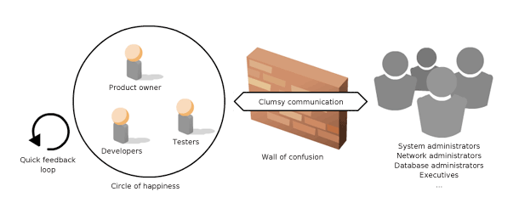
DevOps Breaks Down the “Wall of Confusion”
How does DevOps help?
Notes:
Adam
DevOps means we break down the ‘wall of confusion’ between the “circle of happiness” of functioning agile teams and traditional Infrastructure/Operations teams.

Slide 16



DevOps Aligns Incentives
How does DevOps help?
Typical Scrum Team
Operations Team
Rewarded for change
Rewarded for stability
Measured by velocity
Measured by downtime
Fears blockers/barriers
Fears risks
Notes:
Nick
Sahil Malik – (often referenced on the… ) DotNet Rocks Podcast
Developer Fairies simply want to leverage the best technology to solve a problem
** Very optimistic
Infrastructure Ogres are often more concerned with security, reliability, and performance.
** Very pessimistic

Slide 17
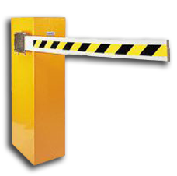
DevOps Supports Feedback and Quality
How does DevOps help?
Brings whole product team into the same iterative process / cadence
Faster feedback due to faster, more reliable deployments
Greater opportunity to build quality & security in up-stream
Security
Penetration
tests
Dynamic
Code
Analysis
Notes:
Nick
Brings more of the operations responsibilities into the product team’s iterative process
** Customers see new versions/features sooner and more regularly to provide feedback on
Up-stream: Done collaboratively early instead of competitively later
** Concerned with catching issues ahead of customers banging on their doors

Slide 18

DevOps Increases Opportunities for Innovation
How does DevOps help?
Example: Pay-as-you-go Service
Metering APIs for billing
Had complexity: Needed to distinguish between internal and external traffic, test calls, etc.
Who owns it?
The Product Team - always
Notes:
Broader awareness of challenges and goals increases opportunity for innovation
Not a trivial implementation
Those who paid attention to Scrum training knows who owns it is a trick question – the team!
Unfortunately, it was put to developers to build it
Ran into issues, meanwhile….
Operations enabled use of network proxy appliance
Developers provided scripting / testing skills to integrate directly into the billing system

Slide 19
DevOps Mitigates Risk
How does DevOps help?
Shorter delivery cycles lead to smaller risk exposure windows for application and infrastructure
Faster response to security issues and critical defects
Adapt quickly to address business risks & market pressure
Notes:
Nick
If you can get a new release out in a matter of hours or even minutes, the risk of a bad release isn’t as severe
When a vulnerability is detected, it can be addressed quickly
-Developers and Operations working together can solve issues more effectively
You don’t want to be unable to deliver new capabilities only to have competitors beat you to it
Competitors could have the advantage if they can adapt to market faster

Slide 20
How do we get there?
DevOps - The Promise of Agility, Delivered
Notes:
Adam
How do you and I, as software professionals, help our organizations and teams adopt DevOps and achieve Continuous Delivery?

Slide 21
Adopting DevOps
How do we get there?
Culture
Practices
Tooling
Notes:
Adopting DevOps means, first and foremost, changing organizational culture.
DevOps also means adopting best-practices (which requires a cooperative culture; open to change!)
Finally, there’s the tooling that supports those practices.

Slide 22
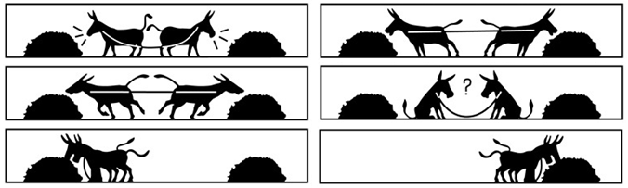
Cultivate a Mindset of Shared Goals
How do we get there?
Notes:
Adam
A Microsoft study showed that 52% of IT professionals identified culture as the top challenge to adopting DevOps.

Slide 23
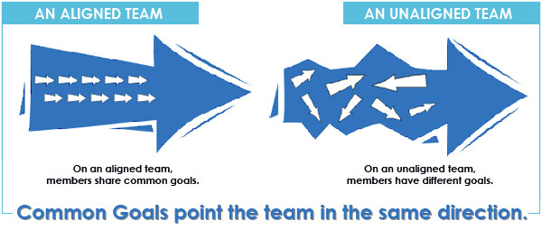
Cultivate a Mindset of Shared Goals
How do we get there?
Notes:
What are the competing goals in software delivery?
Shared Goals means Shared Responsibility and Shared Incentives

Slide 24
Follow Best Practices
How do we get there?
Automated!
Scripted Releases
Unit Testing
Continuous Integration
Load Testing
Acceptance Testing
Code Analysis
Notes:
Adam
Automate it all!
These are just some best practices

Slide 25

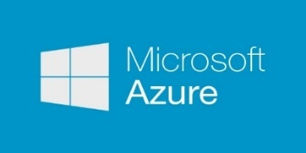
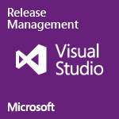

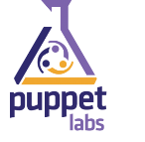




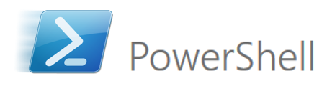









Use the Right Tools
How do we get there?
Advancements in tooling are supercharging the DevOps approach & enabling valuable techniques like continuous delivery & configuration as code.
Notes:
Adam
Use the right tools to:
Enable Continuous Integration (source control)
Manage builds & deployments
Configure scriptable, and disposable infrastructure
Analyze code (static & dynamic analysis)
Monitor live applications
Integrated ALM/testing

Slide 26

Gain Confidence through Monitoring / Diagnostics
How do we get there?
“Sufficiently Advanced Monitoring is Indistinguishable from Testing”
- Ed Keys, GTAC 2007
Notes:
Nick
When getting started, monitoring is a great place to start collaboration between dev and ops
Quote: becomes important as you start driving more frequent releases
Recommend the talk
Important enabler for DevOps, and overtime a great outcome of DevOps

Slide 27
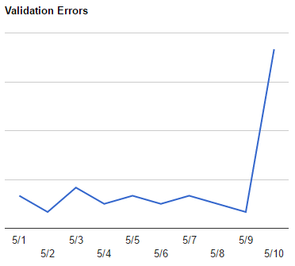
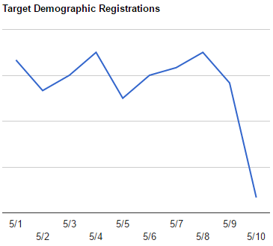
Collaborate to Achieve Business-Driven Monitoring
How do we get there?
Notes:
Nick
1. First metric is typical of off-the-shelf product
Ask audience: What does this graph tell me about the system? Is there something wrong?
Answer: Can’t know. Could be completely benign metric.
OOTB tools offer purely technical telemetry.
2. Second metric requires domain knowledge of what the product is trying to accomplish
A subtle bug slipped through that impacts some types of users from using the system
**Invest in building custom analytics/dashboards/monitoring on metrics that are value-driven to the business
**Collaborate to ask “How do I know the system is *really* working”

Slide 28

Deployment Pipeline
How do we get there?
Run on every change that may impact the system
Infrastructure as Code
Configuration as Code
Data as Code
Automation……..
Notes:
Nick
Key pattern in Continuous Delivery
Data as Code too
Give use case (insurance discount table load)
Does not apply to “data processing”
Pertains to data that is inextricable tied to the business logic (tax tables, pricing rules)

Slide 29
Deployment Pipeline
How do we get there?
Load Tests
Usability Tests
Approve to Production
Promote to Prod
Unit Tests
Performance Tests
Smoke Tests
Dev Deploy
Functional Acceptance Tests
Promote to QA
Exploratory Testing
Sign Off
Build
AUTOMATED
MANUAL
Notes:
Nick
All changes go at least as far into the pipeline as is automated.
Because of cost constraints, manual steps not.
Organization must be structured around:
Product team needs to own this pipeline.
Each product gets its own pipeline.
Defining a deployment pipeline, even a rudimentary one, is another great place to start.

Slide 30

DevOps => Continuous Delivery
Summary
Continuous delivery introduced deployment pipelines
DevOps enables team to own the pipeline for a product, end to end
INSERT VISUALIZATION
Notes:
Adam / Nick
DevOps is the next evolution of agile, helping us to finally achieve the state of continuous delivery by aligning the goals of everyone involved in the software delivery process.
This is accomplished through changes in organizational culture, best-practices, and modern tooling.
Continuous delivery introduced deployment pipelines
DevOps enables team to own the pipeline for a product, end to end
Requires a lot of Inspect & Adapt cycles
Keep refining pipeline
Requires strong team empowerment

Slide 31

questions?
DevOps - The Promise of Agility, Delivered
https://www.surveymonkey.com/r/PathSessions2016

Slide 32
DevOps Is About Shared Goals
What is DevOps?
“DevOps isn't simply a piece of software, a job title, or giving pagers to your developers.
It's a cultural and professional movement. It is everyone working together toward a shared goal - delighting customers. Anyone who tries to sell you something else is pushing you some manure.”
- Shared Goals not horse manure
chef.io/solutions/devops
Notes:
Adam

Slide 33
